Slide 1
ME1304 PMAC Motor
Axial Flux, Surface Permanent Magnet Rotor
AF, SPM, PMAC Motor
Water Cooled

Slide 2
Product Specification
Designed for 24 to 96 VDC battery applications
Continuous Output of 16 kw on 96 VDC battery systems (42 kw peak)
Maximum rotor speed is 5,000 rpm (Passes 8,000 rpm rotor burst test)
Totally Enclosed, Water Cooled motor
UL Insulation system, Class H
Designed to meet NEMA 1004 standards
NTN6006 LLUC3/5K sealed ball bearing (Made in Japan)
Sine/Cosine Rotor Position Sensor (Hall Sensor option available)

Slide 3
Product Specification
Continuous current of 200 A (Sevcon Size 6 Control)
Peak Current of 600 amps
Continuous Torque of 260 Lb In (30 Nm)
Peak Torque of 65 Ft Lb (90 Nm)
150 Amps continuous without water cooling
Options:
3 Hall Sensors, 120 degrees
Metric Shaft and Mounting face
Windings for maximum speeds of 300-5000 rpm
Totally enclosed case
Optional 10,000 hour bearing set

Slide 4
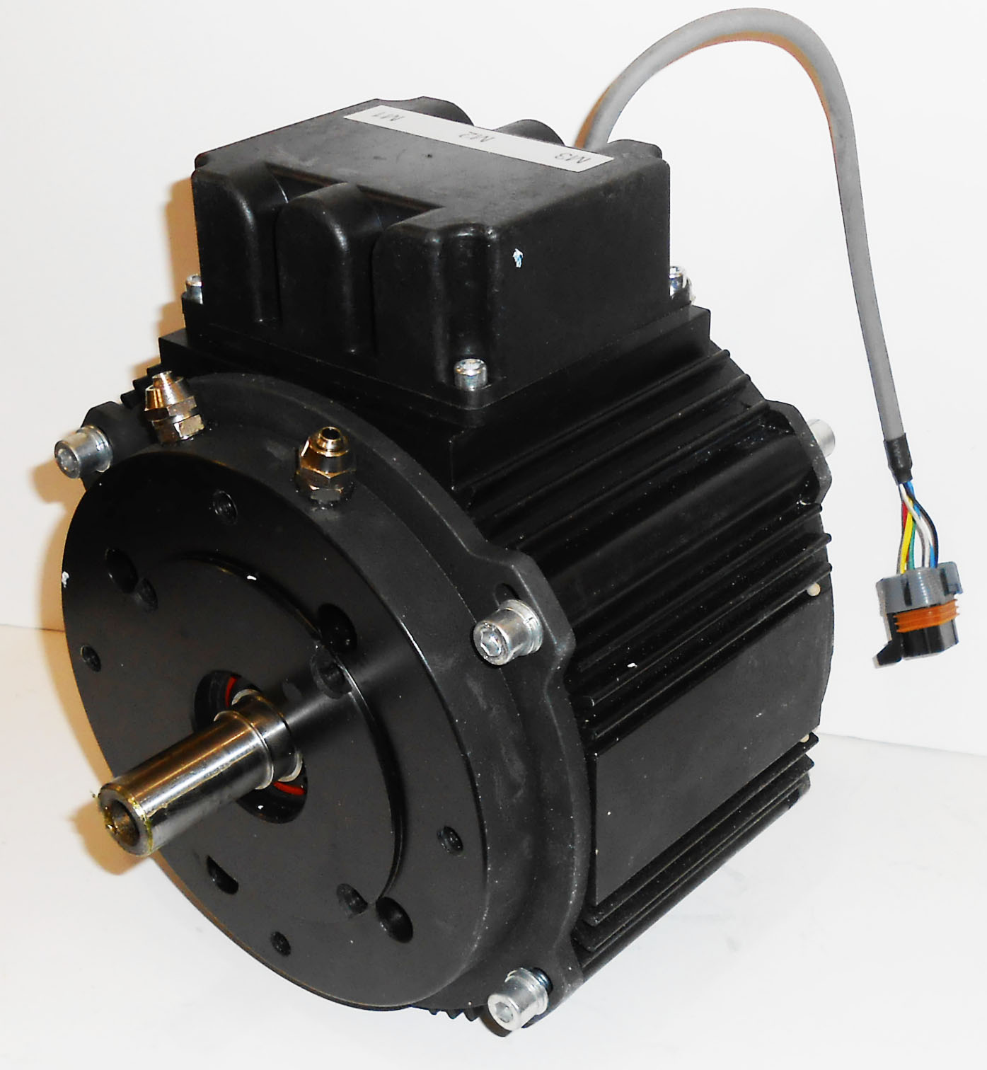
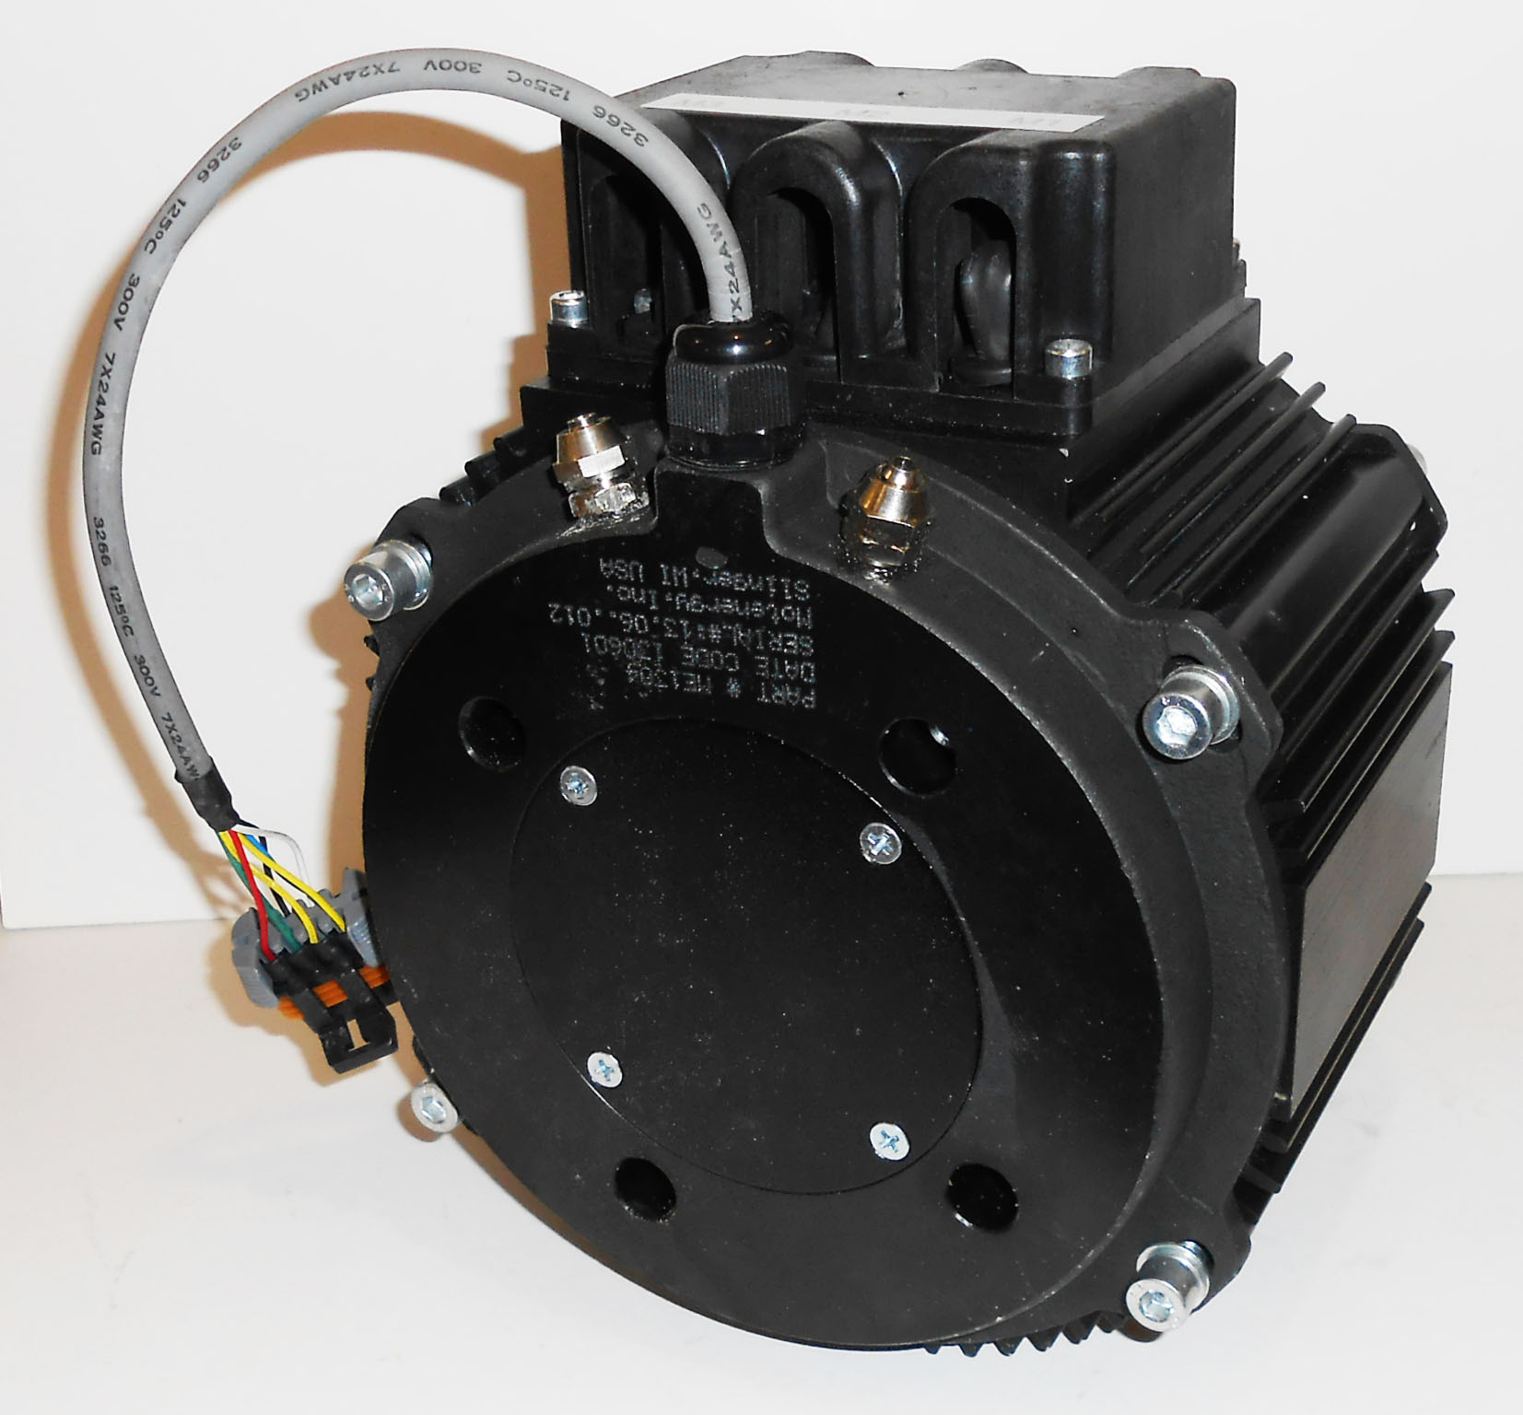

Slide 5
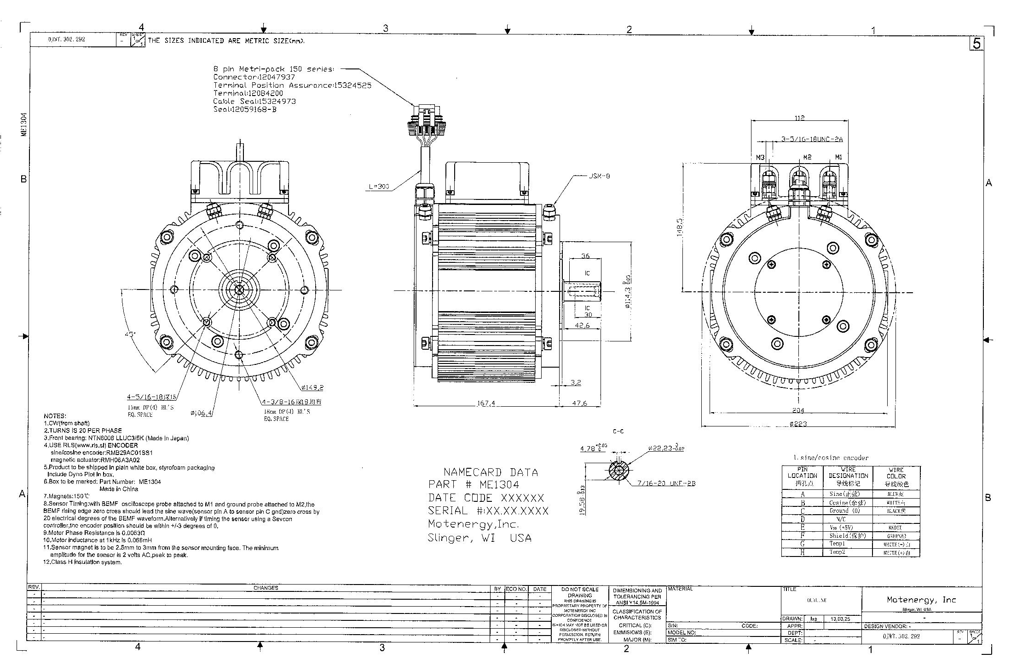

Slide 6
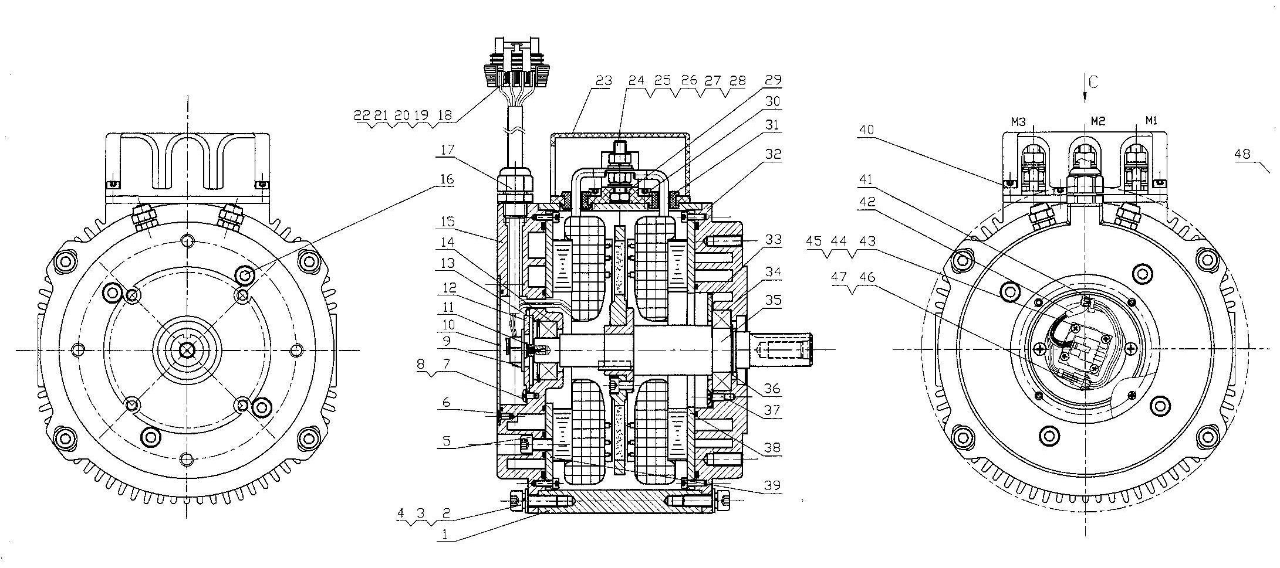

Slide 7
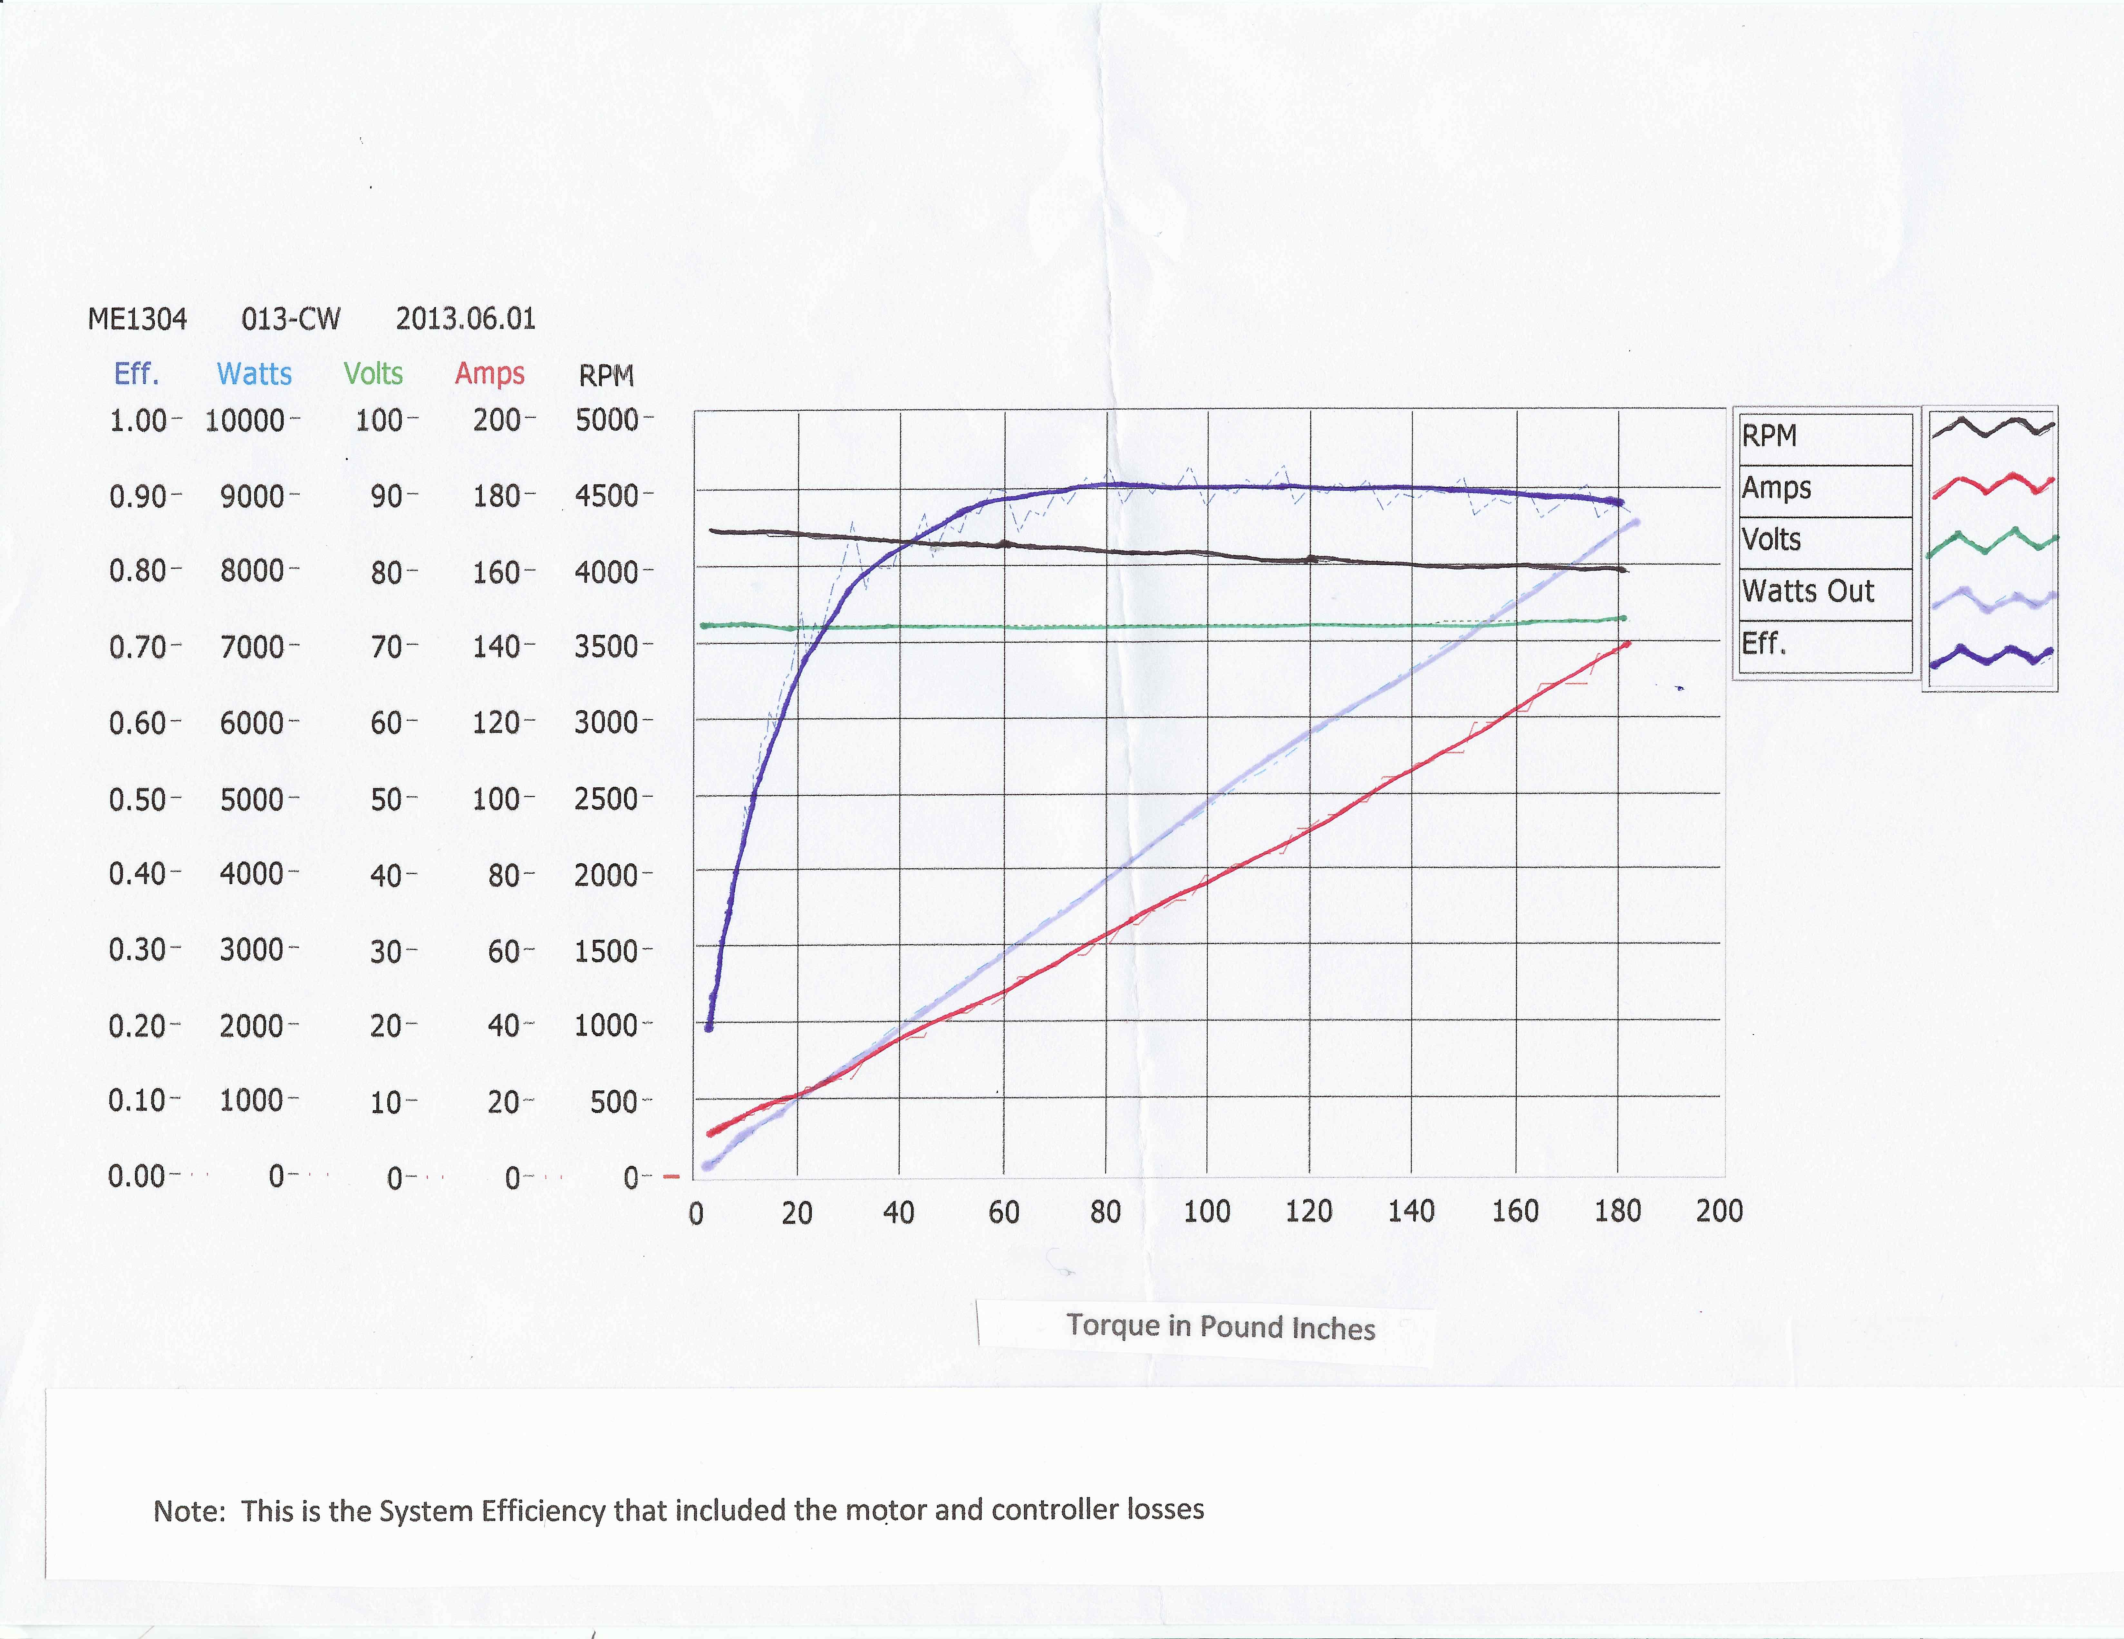

Slide 8
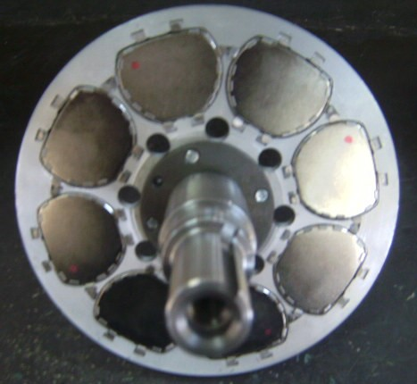
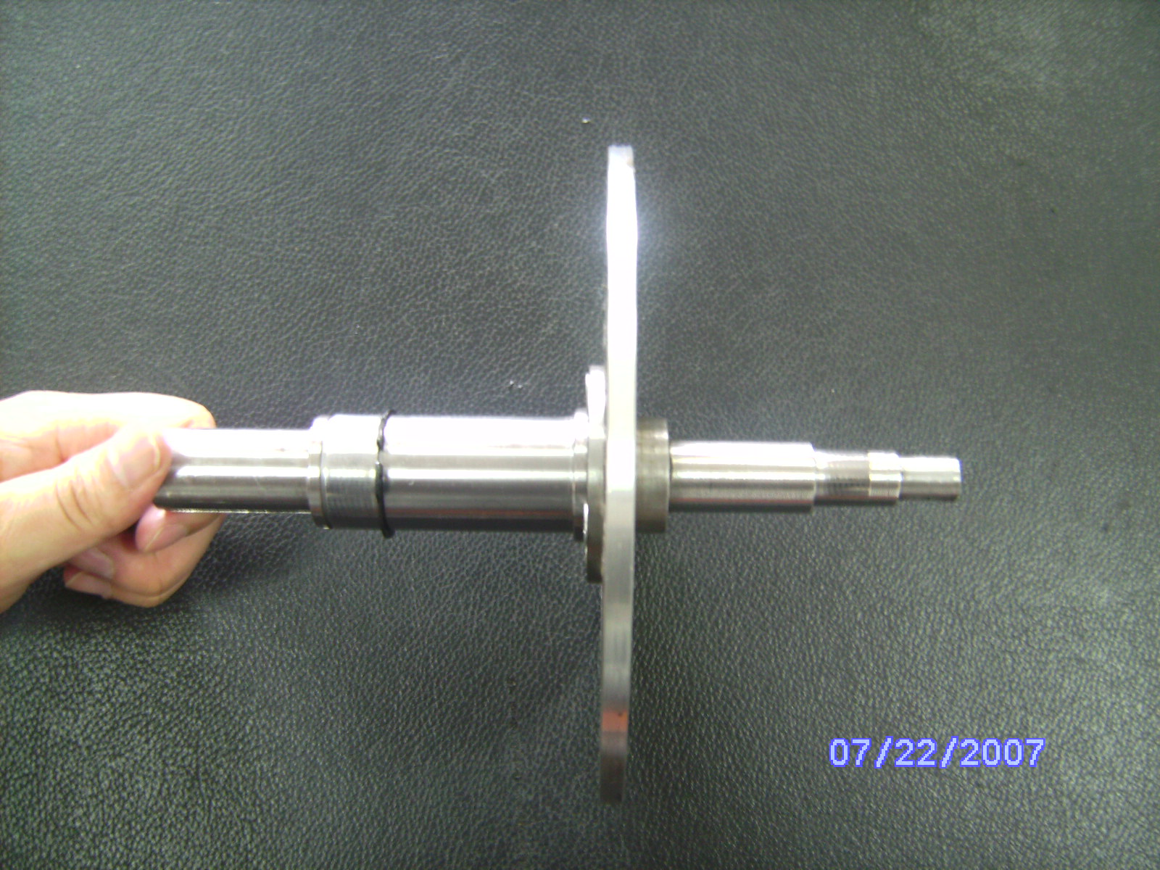
Rotor Specifications
150 C rating (180 C Option)
Sinusoidal Back-EMF
Neodymium Magnets
Passes GM Salt Spray Test
Nichol Plated
Low Inertia for rapid accelerations

Slide 9
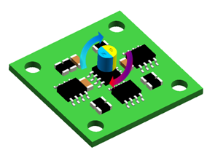
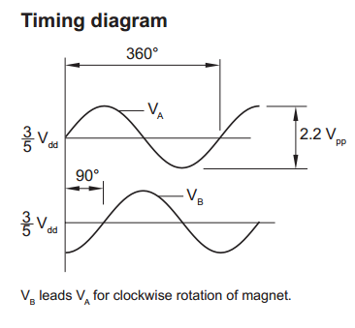
Product Instructions │Ecoder
Parameters
Power supply | Vdd= 5 V ± 5 %
Operating Temperature | -40～+105℃
Maximum speed | 60,000 rpm
Resolution | one sine/cosine wave per revolution
Sin/Cos outputs | Signal amplitude: 1.1 V ± 0.2 V
Power consumption | 20mA
Accuracy | ±0.6°
Hysteresis | 1.62° at 30000 rpm

